Slide 1
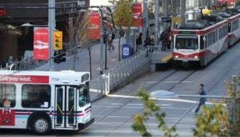
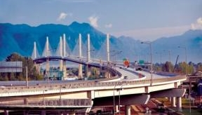
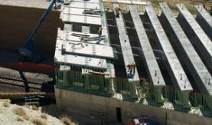
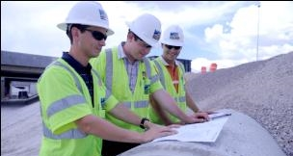
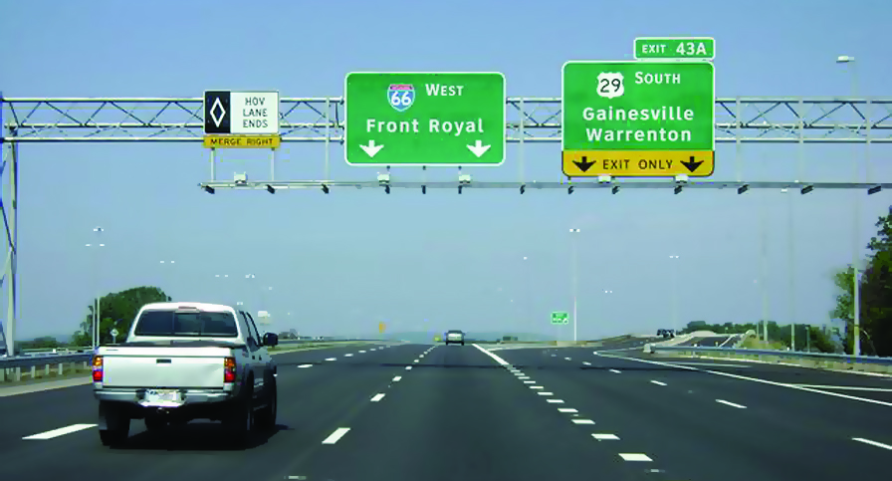




Preservation for High-Traffic-Volume Roadways (R26)
(August 15, 2019)
Steve Cooper
FHWA Pavement & Materials Engineer
Notes:
…. I want to provide you with a short update on the SHRP2 Implementation Assistance Program which, as most of you are aware, is another program FHWA is leading … and it’s something I definitely have enjoyed being involved in.

Slide 2
Objectives
SHRP2 Background
Discuss the R26 Product
Promote R26 IA Product Tools
  Academic Workshop
  Just-in-Time Training
  Analysis Tool
Review website materials
Notes:
Prompt for poll questions

Slide 3


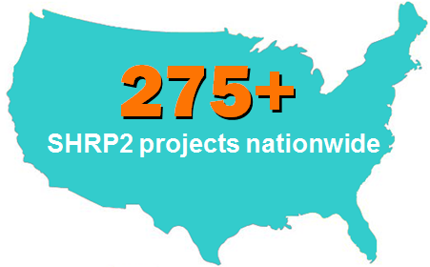
SHRP2 at a Glance
SHRP2
Solutions
Products
Solution Development
Field Testing
Implemen-tation
SHRP2 Education Connection
100
Connecting next-generation
professionals with innovations
430+
Processes
Software,
Test procedures
Specifications
Projects
Adopt into practice
60+
3
Notes:
[Pam Hutton]
SHRP2 is a collaborative effort to develop products and processes that can be used by transportation agencies to address key challenges, including safety, aging infrastructure, and congestion.
TRB completed the SHRP2 research, and now FHWA and AASHTO are jointly implementing the resulting SHRP2 solutions that will help the transportation community enhance the Nation’s highway system.
We call the results of SHRP2 research ‘solutions’ because, in many cases, the products are processes, software, testing procedures, and specifications designed to fill knowledge gaps that have prevented existing innovations from being used more widely.
SHRP2 Solutions fit into existing agency processes and help practitioners advance the state of the practice—by being smarter, using resources more wisely, and engaging key partners in decision making.
SHRP2 Solutions offer new technologies and processes to enhance the efficiency of transportation agencies.
To date, SHRP2 products are being used on more than 275 transportation projects nationwide.
Earlier this year, we also launched a new initiative called SHRP2 Education Connection. This opportunity is designed to introduce SHRP2’s proven innovations and technologies to the next generation of transportation professionals encouraging academia to incorporate SHRP2 Solutions into transportation coursework—and bringing SHRP2 products into the classroom.
3

Slide 4
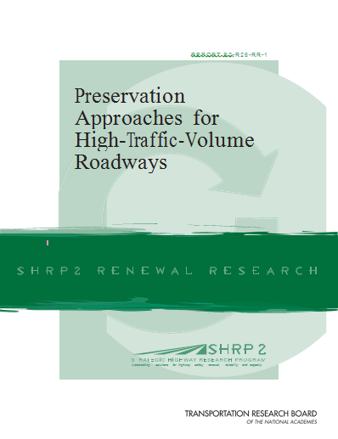
Preservation of High-Traffic-Volume (HTV) Roadways (R26)
Challenge
Preserving Pavements on High-Traffic-Volume Roadways can yield significant benefits but carries a high level of risk,
Many effective pavement preservation techniques exist, but until now they have been used, especially in urban settings, primarily for low-volume roads.
Research Goal
Develop guidelines that will enable transportation agencies to use pavement preservation on High-Traffic-Volume Roadways.
Notes:
I know a lot of you attended the webinar yesterday so you probably already heard about R26 Preservation for high-volume traffic roadways.
The primary Goal for the R26 Project is to demonstrate that preservation can be successfully done on high-traffic-volume highways and identify the best practices used by State agencies.
Under R26, a series of guidelines and technical summaries have been developed to help transportation agencies match roadway conditions to specific preservation strategies, to help transportation agencies identify the best options to maintain heavily-traveled roadways.

Slide 5
Preservation of High-Traffic-Volume Roadways
  Objectives of Product:
    Step-by-step process to identify the best
    repair techniques based on specific
    pavement needs and conditions
    Method for weighing
    various technical inputs
    and selecting the most appropriate treatments
    Decision matrices
Notes:
A SHRP2 Solution now being implemented across 14 DOTs from the first round of implementation is Preservation Techniques for Heavily Traveled Roadways (R26).
Many transportation agencies have been using effective pavement preservation techniques on low-volume roadways. But quick-fixes could also be the answer for higher-volume roads in urban and rural settings.
Under SHRP2, a series of guidelines and technical summaries have been developed to help transportation agencies match roadway conditions to specific preservation strategies. Two documents, (1)Guidelines for the Preservation of High-Volume Roads and (2) Preservation Approaches for High-Traffic-Volume Roadways, have been developed to help transportation agencies identify the best options to maintain heavily-traveled roadways.
These tools provide effective guidance that will enable transportation agencies to extend the service life of a roadway, save construction or rehab costs, and reduce work zone accidents.

Slide 6
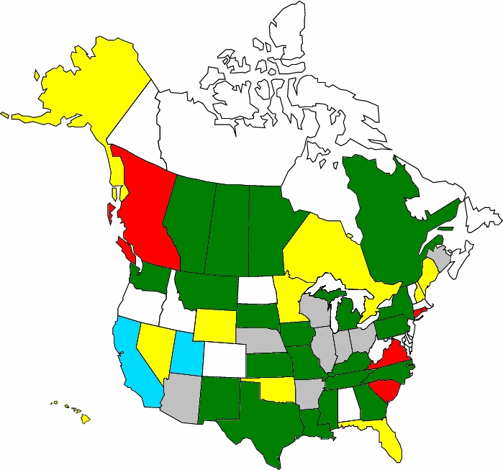
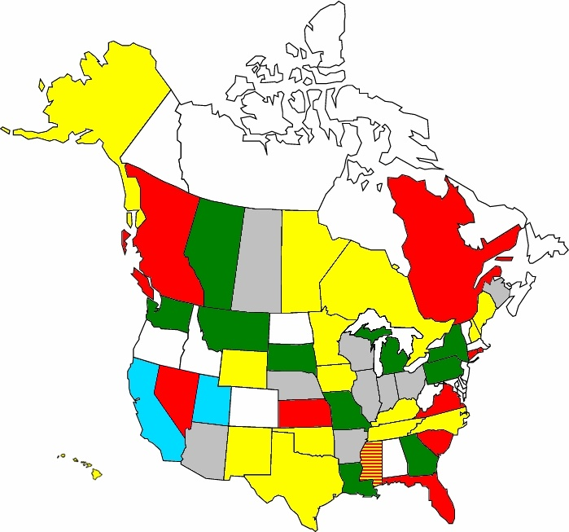

How Do You Define High-Volume?
Green | Low (<10,000) | Yellow | Medium (10,000-19,999) | Red | High (≥20,000)
Rural High-Volume Limits Urban High-Volume Limits
Did not answer
Did not return survey
Notes:
Duration
1-2 minutes
Key message
There is no standard definition for high-volume. As you can see by the graphic, when the R26 study was done there was wide variation in how each state defined this.
Instruction
Explain the color-coding on the graphic.
Ask, “How does your state define ‘high-volume traffic’? Has it changed in the past several years?”
Note: High-volume roads do not necessarily mean high-speed roads.

Slide 7
R26 Selection
Tool – Project
Evaluate Current and Historical
Pavement Performance Data
(from field surveys and testing
and/or agency PMS database)
Overall Condition Indicator (PCI, PSR, etc.)
Individual Distress Types, Severities, and Extents
Smoothness (IRI, PI, etc.)
Surface and Subsurface Drainage Characteristics
Safety Characteristics
  friction/texture (FN, MPD/MTD, IFI, etc.)
  crashes
Pavement–Tire Noise
Review Historical Design, Construction,
and Maintenance and Rehabilitation (M&R) Data
  Pavement Type and Cross-Sectional Design
Materials and As-Built Construction
M&R Treatments (materials, thicknesses, etc.)
Decision
Develop Preliminary Set of Feasible Preservation Treatments

Slide 8
R26 Selection
Tool – Treatment(s)
Develop Preliminary Set of Feasible Preservation Treatments
Assess Specific Needs and Constraints of Project
Performance Needs
Treatment Life
traffic effects (functional class and/or traffic level)
climate/environment effects
  Risk
    Availability of qualified contractors
Availability of quality materials
Construction Constraints
  Funding
  Time (of year) of construction
  Geometrics
Work duration (facility downtime)
Traffic accommodation
Develop Final Set of Feasible Preservation Treatments
Select the Preferred Preservation Treatment
Conduct Cost-Effectiveness Analysis
Benefit-Cost Analysis
Life-Cycle Cost Analysis (LCCA)
Evaluate Economic and Non-Economic Factors

Slide 9
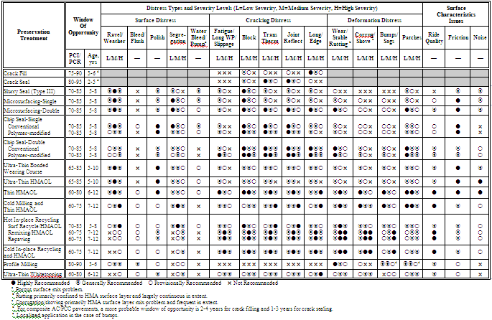
Feasible Treatments –
Bituminous-Surfaced

Slide 10
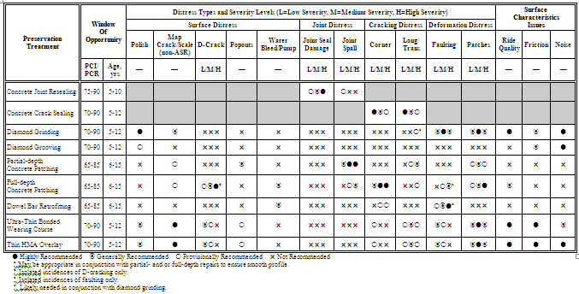
Feasible Treatments –
PCC-Surfaced

Slide 11
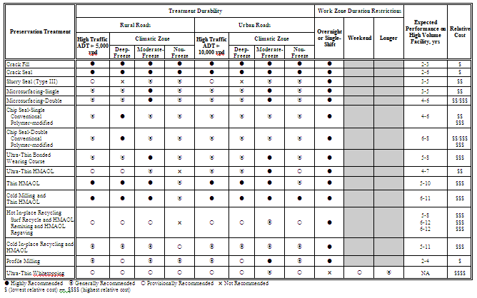
Secondary Selection –
Bituminous-Surfaced

Slide 12
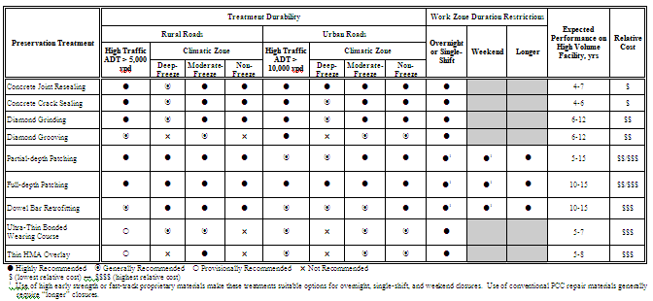
Secondary Selection –
PCC-Surfaced

Slide 13
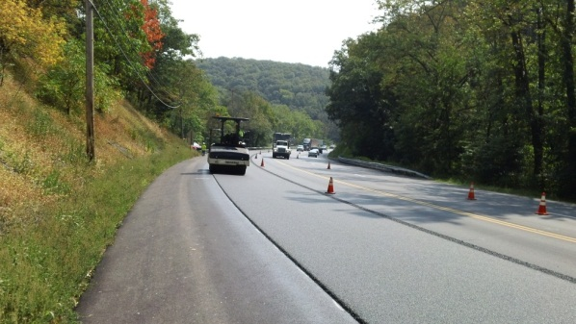
SHRP2 R26 Strategies for Implementation
  Build adoption through project incentives, technical support, and peer exchanges among early implementer States
  Market the program through showcases, webinars, speaking engagements, etc.
  Provide technical resources by developing a tool box and training programs/workshops
  Link efforts to partner organizations
Notes:
In additional to the Implementation Assistance Program, AASHTO and FHWA will also offer peer-to-peer exchanges, extensive case studies, and, ultimately, an e-tool that documents the product’s success in determining accurate pavement options. Our goal is to expand the use of this product beyond the original 14 lead adopters and users.
We already have some connections through AASHTO to work with the TIG program. We are looking to get the pavement preservation industry involved. There is room for more partners as well such as ASCE, APWA. Etc.

Slide 14


Implementation Update –
Pavement Products
1
DEBUTS
R04, R09, R10, R26
R07, R09, R19
R02, R05, R23, R15B
R06A, R06C IR, R06 GPR, R06E, R06G, R09, R10, R19A, R21
R01A, R07, R16
R01B, R05, R15B, R21
2013
2
3
2014
4
5
2015
6
7
(Util:R01A/B, R15B), R06A, R06B, R06D,
R26, R06A, R06G, R19A, R19B
2016
All SHRP2 efforts completed by end of FY19 and transitioned to Post SHRP2
Notes:
Our formal implementation assistance program started in 2013 with typically 2 rounds of Solutions being offered each year, with rounds 1 and 2 being offered in 2013, Rounds 3 & 4 in 2014, and Rounds 5 & 6 being offered in 2015. We also just advertised Round 7 last month which is our last and final round of solutions in our program … and I’ll talk about thist shortly. If we just look at the Renewal Products in rounds 1 thru 6, we’ve had 19 solutions being offered, with few being offered more than once to offer agencies with more opportunities to formally participate in the program. Our renewal products fall into the categories of pavements, structures, utilities, railroad, and construction. The solutions highlight in yellow are pavement related products that I’ll highlighting next.

Slide 15
Guidelines Round 1
Implementation Efforts
Released to state DOTs as part of FHWA/AASHTO’s Implementation Assistance Program
Funding support through SHRP2
  14 agencies selected
  Funding and programming support ongoing
Technical and programming support from
  FHWA
  AASHTO

Slide 16
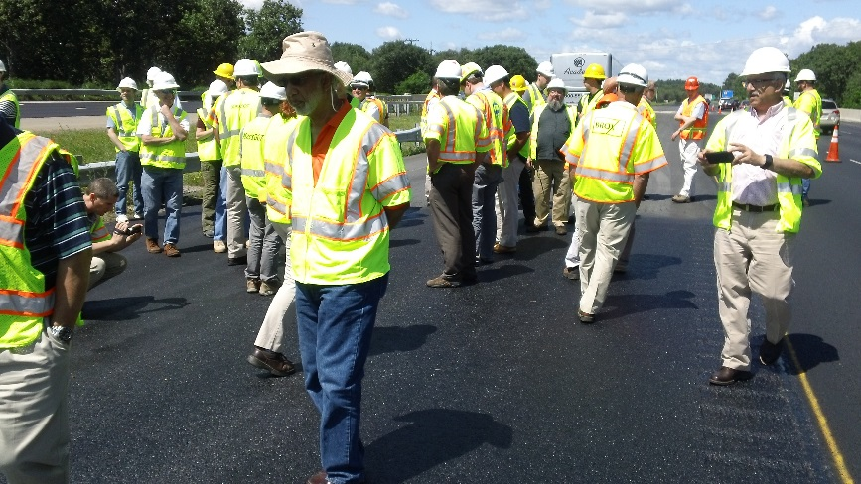
Program Support
  Round 1 Activities:
    Preservation Projects (14 Agencies/32 projects/40 treatments)
    Open House (MN DOT)
    Showcase (MA DOT)
    Peer Exchanges (4 Peer Exchanges)
    Quarterly User group Conference Calls
    Workshops (3 Workshops)
    Marketing Materials
    Products: (Preservation Analysis Tool)
    Website Development
Notes:
With the 14 agencies presently participating, in total they executed 32 preservation project and placed over 40 preservation treatments on high volume traffic roadways.
We also conducted a Showcase in Mass on July of 2015 to review a project along Route 3 that had over 100,000 ADT,
Had an open house at MNRoads
Held three 4-hrs workshops
Held Quarterly Usergroup webinars,
And conducted 1 peer exchange, with two more scheduled in the near future (at Williamsport, PA on 29 June 2016 and St. Louis, MO on 9 Aug 2016)
This is just an example of the activities typically provided for each solution being implemented.

Slide 17
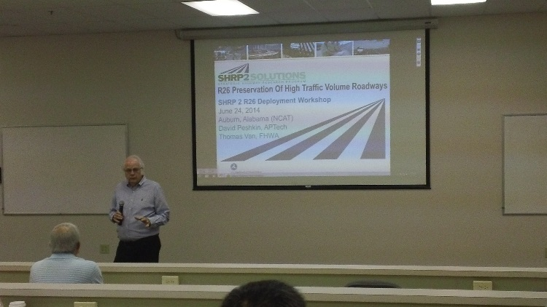
R26 Continued Support
Round 7 Activities (FY18/FY19):
  Program Reviews (WA, WV, NJ)
  On-line “Just-in-Time” Training Development
  Development and Delivery of a 4-hr Academic Workshop
  Additional Marketing Materials
  AASHTO SHRP2 R26 Website Update

Slide 18
R26 Preservation for High-
Volume-Traffic roadways
AK
WA
VT
MT
ME
ND
OR
MN
NH
WI
NY
MA
ID
SD
RI
WY
MI
NE
IA
PA
CT
NJ
DE
MD
NV
IL
IN
OH
UT
CO
WV
CA
KS
MO
KY
VA
DC
Northern
Mariana
Islands /
Guam
TN
NC
AZ
OK
AR
NM
SC
MS
AL
GA
American
Soma
TX
LA
HI
FL
V.I.
Round 1
PR
Round 7
Notes:
In our Implementation Assistance Program we presently have 13 state agencies and the District of Columbia participating in R26. I should say, we also included R26 in Round 7 of our program, and although the results have not been released yet, we did receive new applications from WV, NJ and AL, as well as another request from WA State. WA DOT’s application was kind of interesting for they were requesting support in preparing web-based “just in time” training … something Jason Dietz also mentioned yesterday as a need.

Slide 19
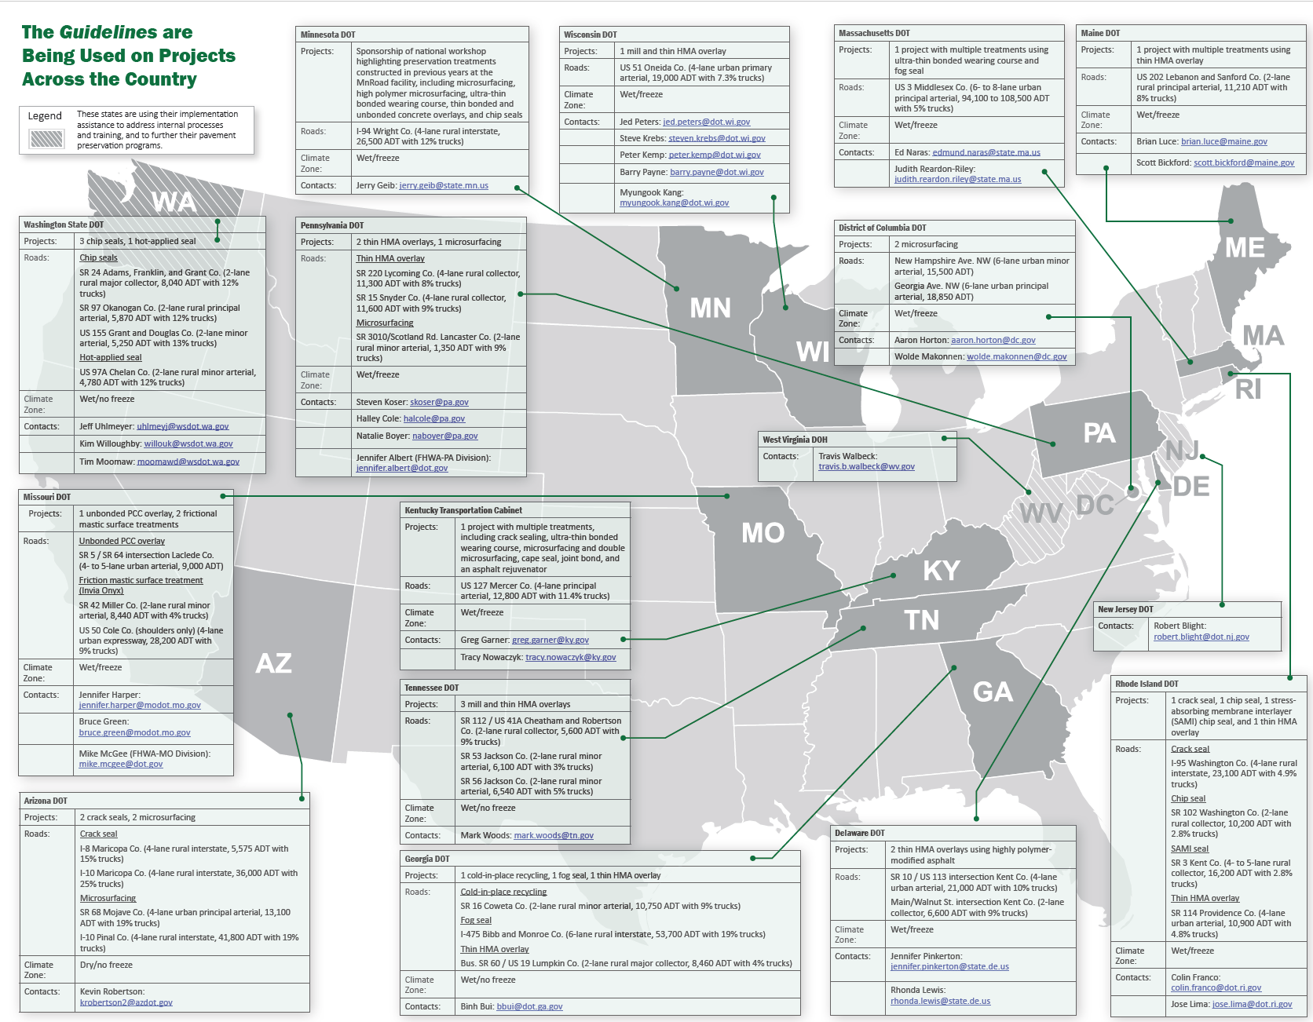
Overview Brochure
Notes:
With the 14 agencies presently participating, in total they executed 32 preservation project and placed over 40 preservation treatments on high volume traffic roadways.
We also conducted a Showcase in Mass on July of 2015 to review a project along Route 3 that had over 100,000 ADT,
Had an open house at MNRoads
Held three 4-hrs workshops
Held Quarterly Usergroup webinars,
And conducted 1 peer exchange, with two more scheduled in the near future (at Williamsport, PA on 29 June 2016 and St. Louis, MO on 9 Aug 2016)
This is just an example of the activities typically provided for each solution being implemented.

Slide 20
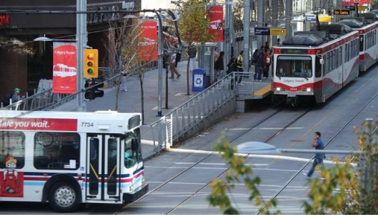
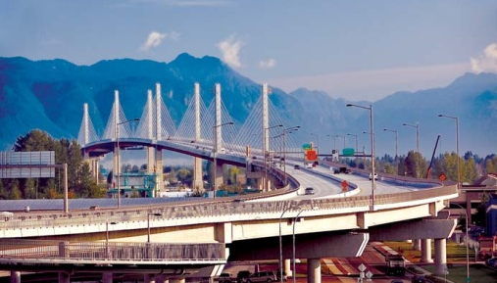
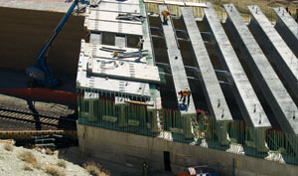
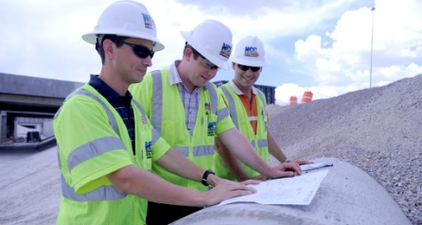
SHRP 2 R26 Guidelines for the Preservation of High-Traffic Volume Roadways
Workshop
(Available to Agencies upon request)
Notes:
Lesson Duration: 20 minutes
Duration
Present until you are ready to begin the workshop
Key message
This 4-hour workshop is based on the research and guidance developed for the SHRP 2 R26 project, “Guidelines for the Preservation of High-Traffic Volume Roadways,” and the lessons learned from the Federal Highway Administration (FHWA) and American Association of State Highway and Transportation Officials-supported implementing agencies.
Instruction
Welcome participants as they enter the room.

Slide 21

Our Goal for You
Develop an approach for including high-traffic volume roadways (HTVR) in the agency’s pavement preservation program
Notes:
Duration
2-3 minutes
Key message
The workshop is intended to help you apply the R26 research, as the goal states.
Instruction
Ask, “Why might your agency want to develop an approach for including HTVR?” Potential answers include: Longer lasting roads; improved performance; Smoother roads; Safer pavement surfaces; Lower agency costs over life of pavement; Shorter construction times; Greater user satisfaction.
Record answers on a flip chart.
Once answers are provided, ask, “Do any of these benefits feature in your agency’s performance targets?” Use answers to emphasize that preservation is a growing segment of many agencies’ programs as they work to meet goals given budget constraints.

Slide 22
How Will You Reach the Goal?
Explain the similarities and differences between applying pavement preservations treatments to low- and high-traffic volume roadways
Describe the information needed to make treatment decisions with minimal risk of failure
Notes:
Duration
1 minute
Key message
By the end of today’s workshop, you will have mastered each of these learning outcomes that help you develop an approach.
Instruction
Ask, “What types of information might you need from this workshop to develop an approach?” Answers might include: the fundamentals of pavement preservation as applied to high-traffic volume highways; the selection tools and evaluation techniques that can be applied to high-traffic volume roadways and how these tools and techniques reduce the risk of treatment failure; and lessons learned from agencies applying preservation to high-traffic volume roadways.
Once answers have been provided, present the first outcome.
Relate the outcome to the answers provided to the question as appropriate.
Animate the slide to present the second outcome.

Slide 23
How Will We Reach the Goal?
Modify preservation decision-making protocols and tools to include HTVR candidates
Identify other changes that need to be made to your agency’s preservation program to successfully include HTVR
Describe the resources available to help you include HTVR in your preservation program
Notes:
Duration
1 minute
Key message
By the end of today’s workshop, you will have mastered each of these learning outcomes which help you achieve the goal.
Instruction
Animate the slide three times to present the three outcomes.

Slide 24
Workshop Overview
DURATION | TOPIC
20 min | Welcome and Introductions
30 min | Lesson 1 – Comparing Preservation on Low- and High-Traffic Volume Roads
55 min | Lesson 2 – Making Preservation Decisions
10 min | Break
75 min | Lesson 3 – Including HTVR in Your Preservation Program
50 min | Lesson 4 – Resources that Support Inclusion of HTVR in Your Preservation Program
Notes:
Duration
1 minute
Key message
This is the order in which the content is presented.
Instruction
Quickly review the agenda, found on page 5 of the workbook.
Explain that each of the lessons addresses one or more of the previous learning outcomes.

Slide 25
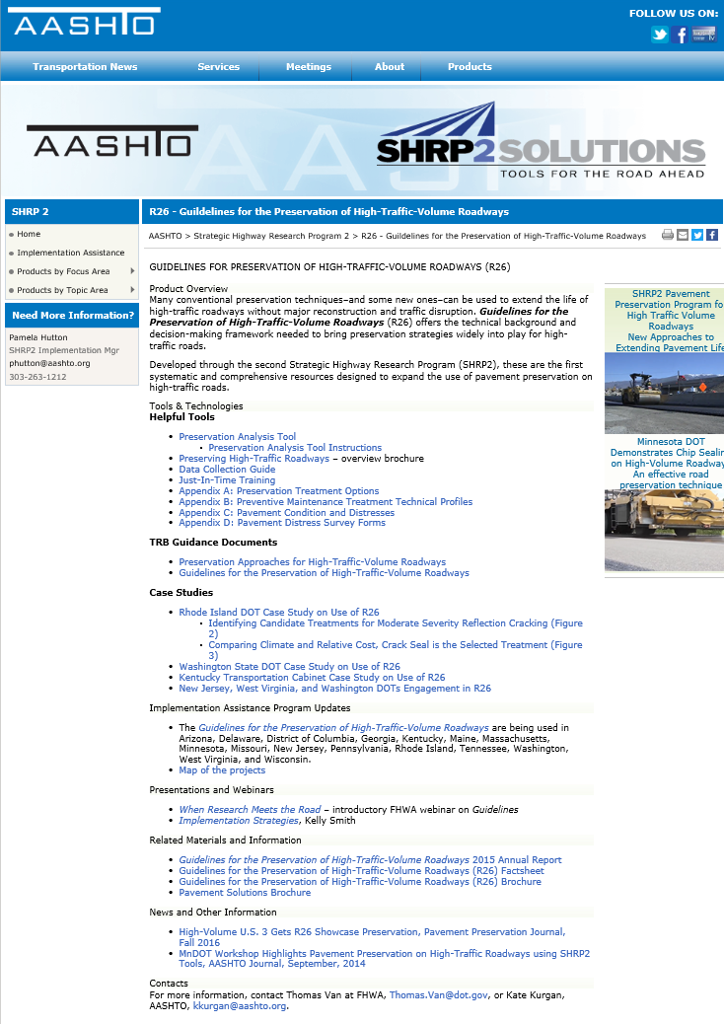
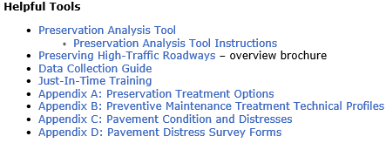
AASHTO SHRP2 Website
(http://shrp2.transportation.org)
Notes:
With the 14 agencies presently participating, in total they executed 32 preservation project and placed over 40 preservation treatments on high volume traffic roadways.
We also conducted a Showcase in Mass on July of 2015 to review a project along Route 3 that had over 100,000 ADT,
Had an open house at MNRoads
Held three 4-hrs workshops
Held Quarterly Usergroup webinars,
And conducted 1 peer exchange, with two more scheduled in the near future (at Williamsport, PA on 29 June 2016 and St. Louis, MO on 9 Aug 2016)
This is just an example of the activities typically provided for each solution being implemented.

Slide 26
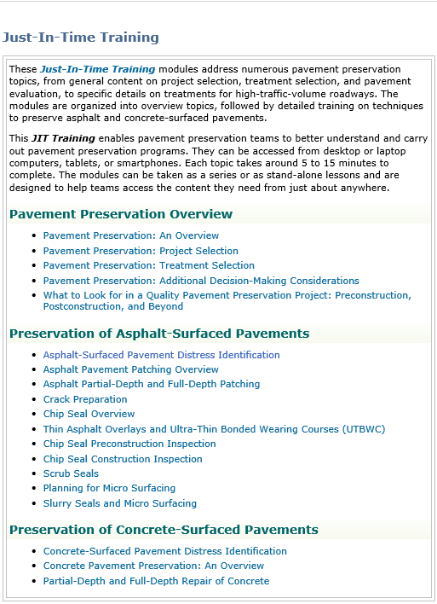
Just-In-Time Training
(http://shrp2.transportation.org/Pages/Just-In-Time-Training.aspx)
Notes:
With the 14 agencies presently participating, in total they executed 32 preservation project and placed over 40 preservation treatments on high volume traffic roadways.
We also conducted a Showcase in Mass on July of 2015 to review a project along Route 3 that had over 100,000 ADT,
Had an open house at MNRoads
Held three 4-hrs workshops
Held Quarterly Usergroup webinars,
And conducted 1 peer exchange, with two more scheduled in the near future (at Williamsport, PA on 29 June 2016 and St. Louis, MO on 9 Aug 2016)
This is just an example of the activities typically provided for each solution being implemented.

Slide 27
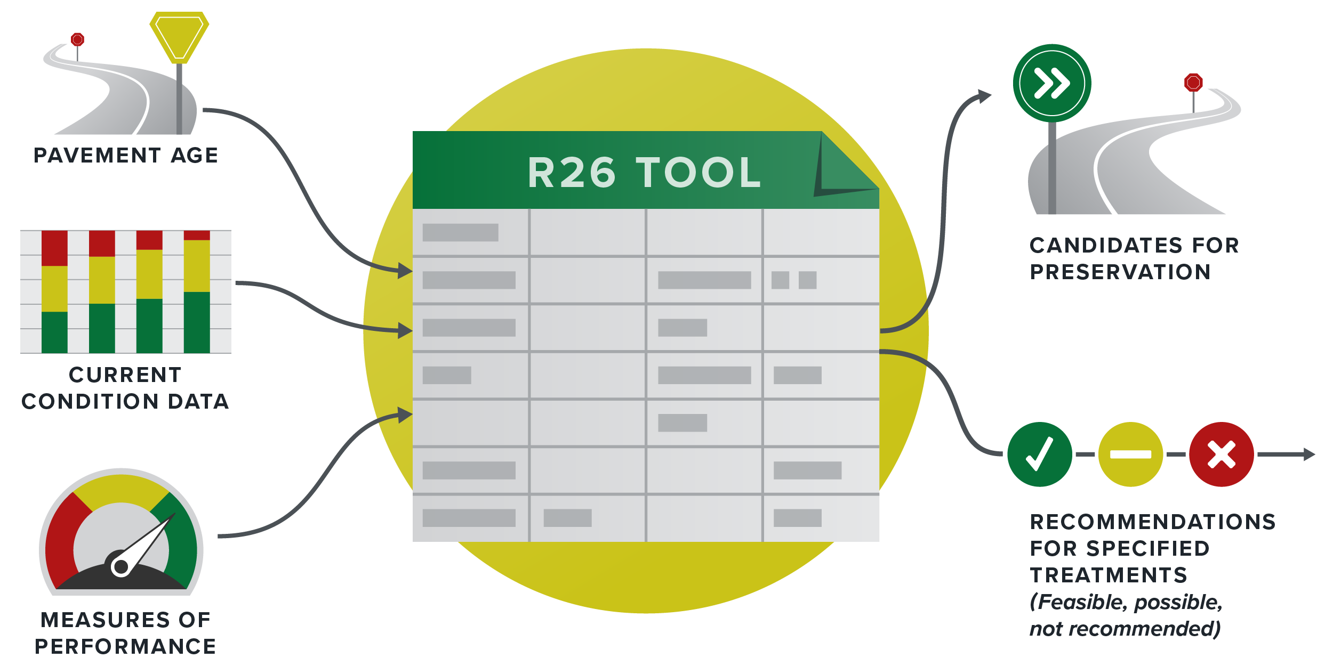
R26 Anaylsis Tool Demo
Notes:
Duration
1 minute
Key message
A tool was developed under R26 to automate some of the decision-making procedures that we completed in Lessons 2 and 3.
Instruction
State that agencies have available to them automatic decision-making tools to assist with treatment selection at the project level.
Use the graphic to introduce the R26 tool at a high level. Advance to the next slide to provide a detailed explanation.
Refer participants to the hyperlink for further information on the tool. This is also where they can download it. http://shrp2.transportation.org/Pages/R26_HighTrafficVolRoadways.aspx

Slide 28
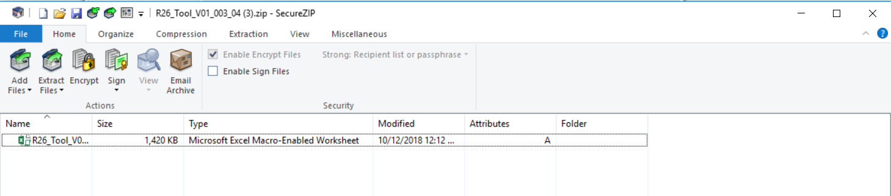
Preservation Analysis Tool Link
Notes:
With the 14 agencies presently participating, in total they executed 32 preservation project and placed over 40 preservation treatments on high volume traffic roadways.
We also conducted a Showcase in Mass on July of 2015 to review a project along Route 3 that had over 100,000 ADT,
Had an open house at MNRoads
Held three 4-hrs workshops
Held Quarterly Usergroup webinars,
And conducted 1 peer exchange, with two more scheduled in the near future (at Williamsport, PA on 29 June 2016 and St. Louis, MO on 9 Aug 2016)
This is just an example of the activities typically provided for each solution being implemented.

Slide 29
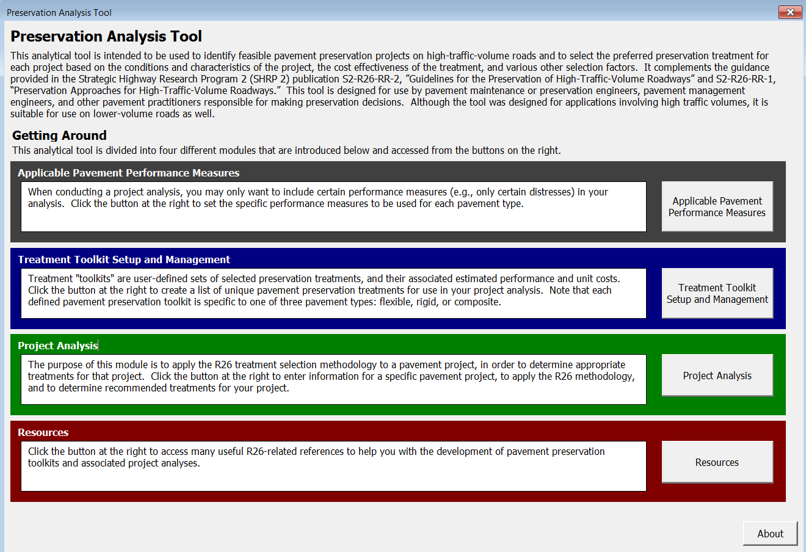
Preservation Analysis Tool

Slide 30
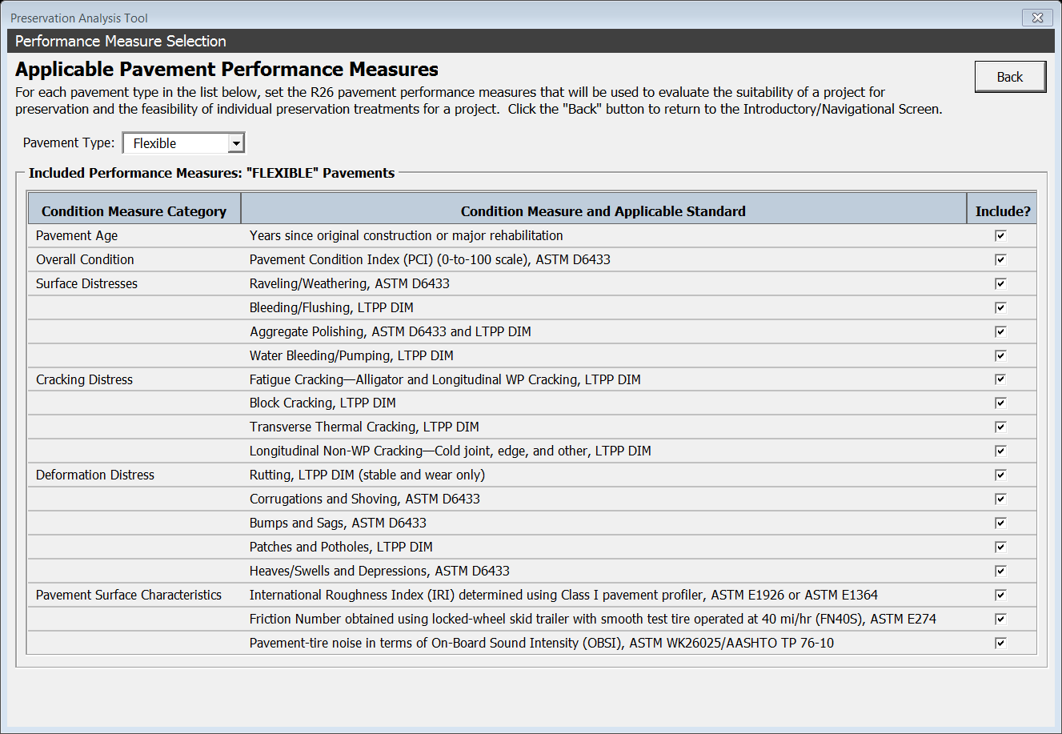
Applicable Pavement Performance Measures - Example
Notes:
With the 14 agencies presently participating, in total they executed 32 preservation project and placed over 40 preservation treatments on high volume traffic roadways.
We also conducted a Showcase in Mass on July of 2015 to review a project along Route 3 that had over 100,000 ADT,
Had an open house at MNRoads
Held three 4-hrs workshops
Held Quarterly Usergroup webinars,
And conducted 1 peer exchange, with two more scheduled in the near future (at Williamsport, PA on 29 June 2016 and St. Louis, MO on 9 Aug 2016)
This is just an example of the activities typically provided for each solution being implemented.

Slide 31
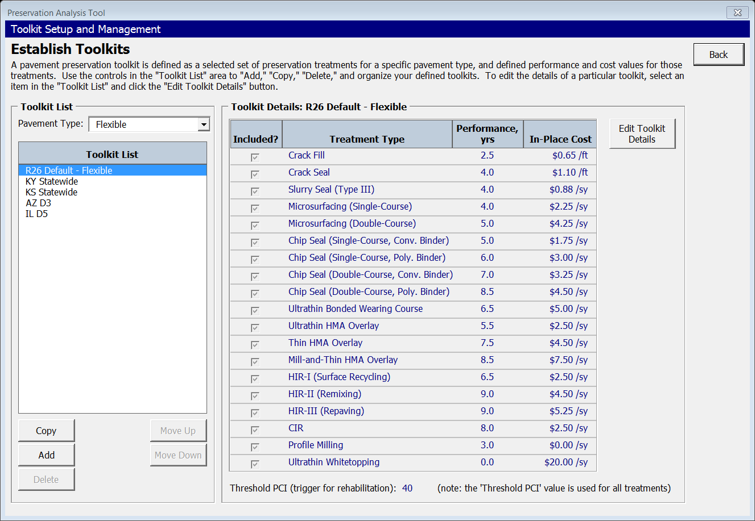
Establish Toolkit - Example
Notes:
With the 14 agencies presently participating, in total they executed 32 preservation project and placed over 40 preservation treatments on high volume traffic roadways.
We also conducted a Showcase in Mass on July of 2015 to review a project along Route 3 that had over 100,000 ADT,
Had an open house at MNRoads
Held three 4-hrs workshops
Held Quarterly Usergroup webinars,
And conducted 1 peer exchange, with two more scheduled in the near future (at Williamsport, PA on 29 June 2016 and St. Louis, MO on 9 Aug 2016)
This is just an example of the activities typically provided for each solution being implemented.

Slide 32
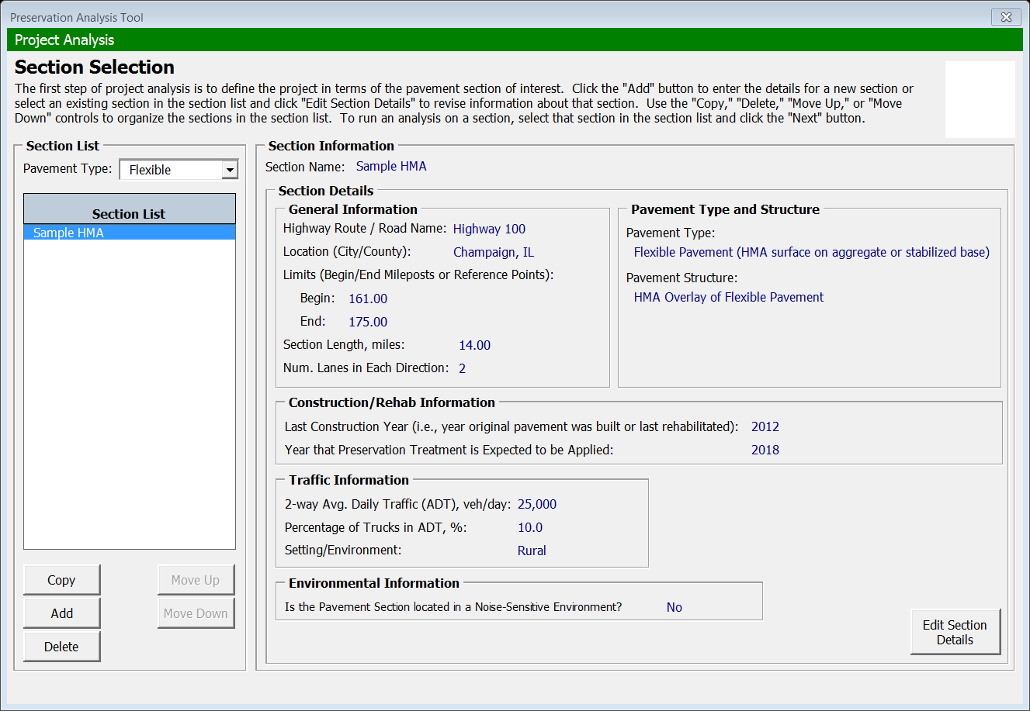
Project Analysis - Example
Notes:
With the 14 agencies presently participating, in total they executed 32 preservation project and placed over 40 preservation treatments on high volume traffic roadways.
We also conducted a Showcase in Mass on July of 2015 to review a project along Route 3 that had over 100,000 ADT,
Had an open house at MNRoads
Held three 4-hrs workshops
Held Quarterly Usergroup webinars,
And conducted 1 peer exchange, with two more scheduled in the near future (at Williamsport, PA on 29 June 2016 and St. Louis, MO on 9 Aug 2016)
This is just an example of the activities typically provided for each solution being implemented.

Slide 33
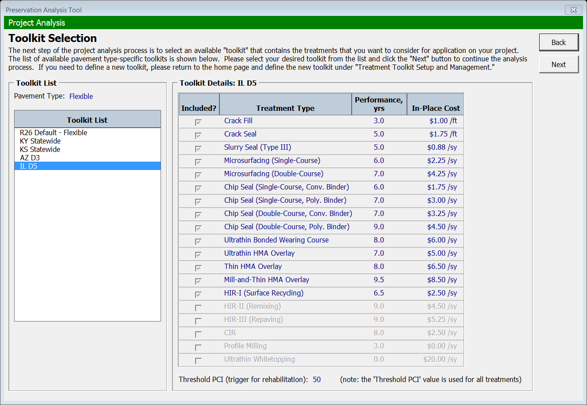
Project Analysis -Example (Cont.)
Notes:
With the 14 agencies presently participating, in total they executed 32 preservation project and placed over 40 preservation treatments on high volume traffic roadways.
We also conducted a Showcase in Mass on July of 2015 to review a project along Route 3 that had over 100,000 ADT,
Had an open house at MNRoads
Held three 4-hrs workshops
Held Quarterly Usergroup webinars,
And conducted 1 peer exchange, with two more scheduled in the near future (at Williamsport, PA on 29 June 2016 and St. Louis, MO on 9 Aug 2016)
This is just an example of the activities typically provided for each solution being implemented.

Slide 34
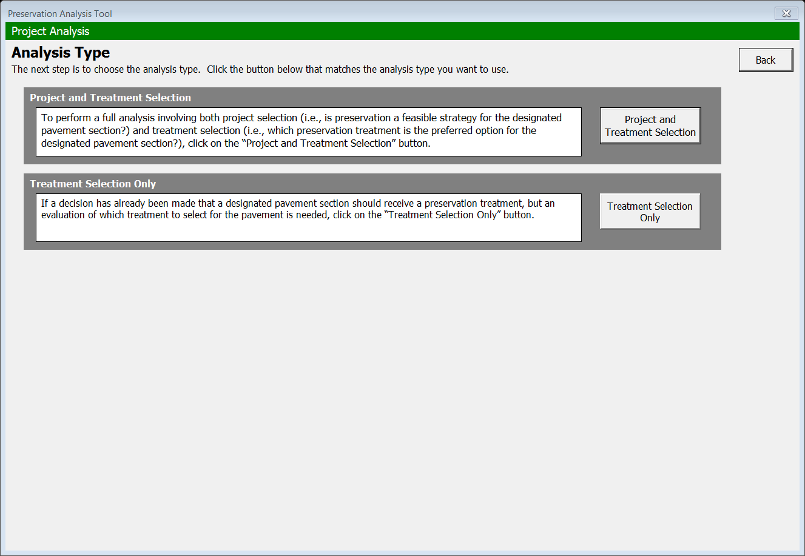
Project Analysis - Example (Cont.)
Notes:
With the 14 agencies presently participating, in total they executed 32 preservation project and placed over 40 preservation treatments on high volume traffic roadways.
We also conducted a Showcase in Mass on July of 2015 to review a project along Route 3 that had over 100,000 ADT,
Had an open house at MNRoads
Held three 4-hrs workshops
Held Quarterly Usergroup webinars,
And conducted 1 peer exchange, with two more scheduled in the near future (at Williamsport, PA on 29 June 2016 and St. Louis, MO on 9 Aug 2016)
This is just an example of the activities typically provided for each solution being implemented.

Slide 35
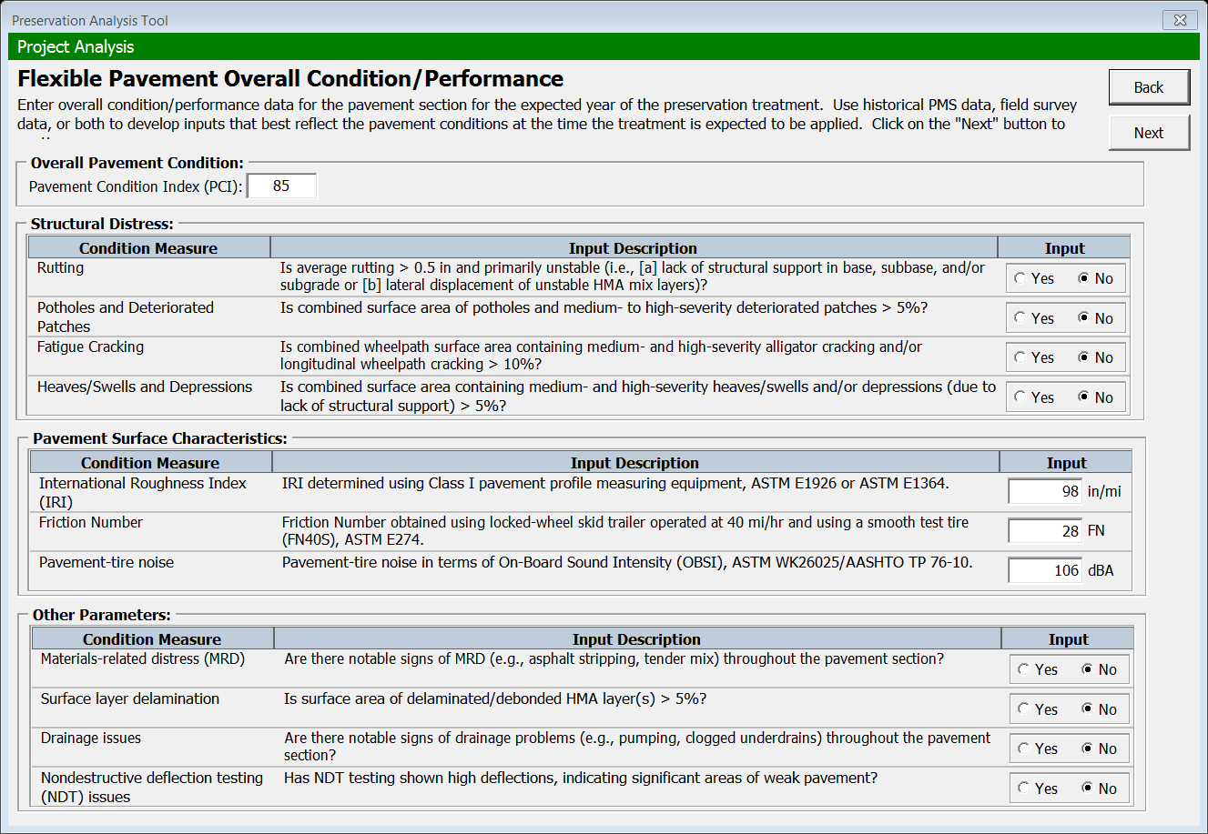
Project Analysis - Example (Cont.)
Notes:
With the 14 agencies presently participating, in total they executed 32 preservation project and placed over 40 preservation treatments on high volume traffic roadways.
We also conducted a Showcase in Mass on July of 2015 to review a project along Route 3 that had over 100,000 ADT,
Had an open house at MNRoads
Held three 4-hrs workshops
Held Quarterly Usergroup webinars,
And conducted 1 peer exchange, with two more scheduled in the near future (at Williamsport, PA on 29 June 2016 and St. Louis, MO on 9 Aug 2016)
This is just an example of the activities typically provided for each solution being implemented.

Slide 36
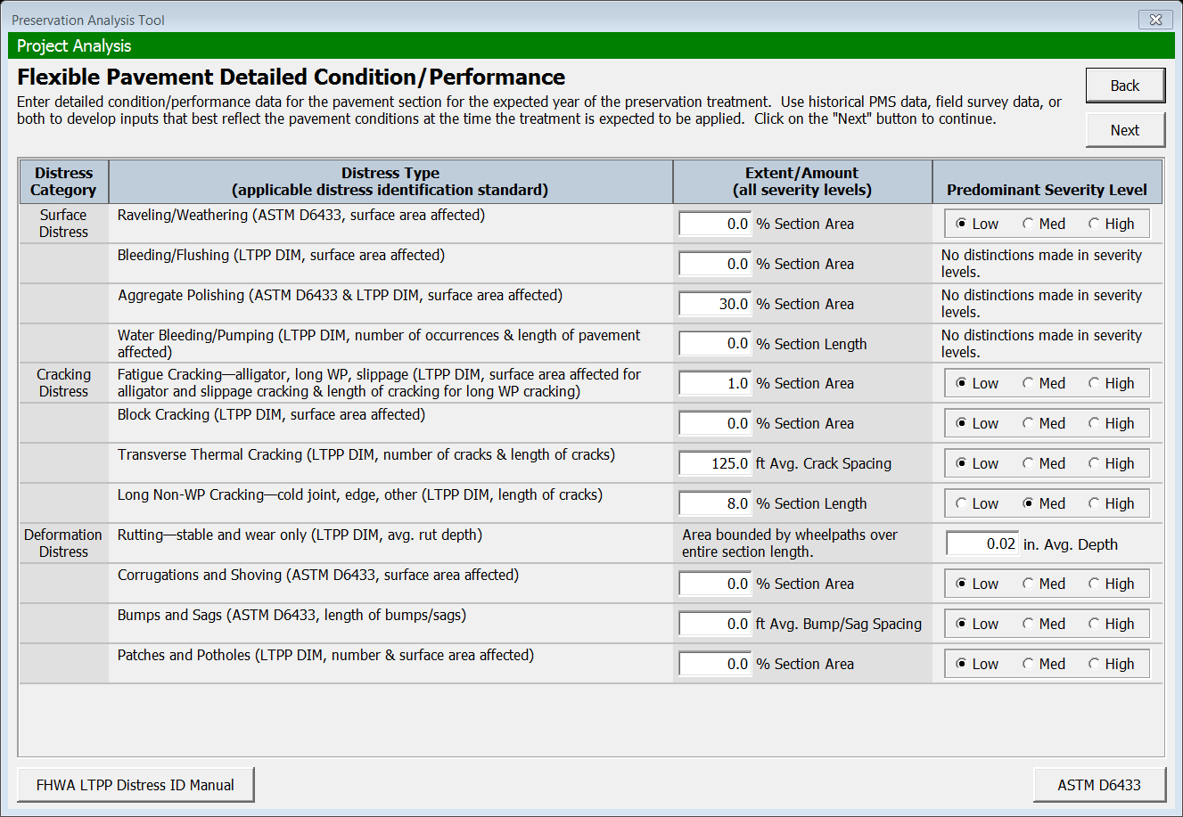
Project Analysis - Example (Cont.)
Notes:
With the 14 agencies presently participating, in total they executed 32 preservation project and placed over 40 preservation treatments on high volume traffic roadways.
We also conducted a Showcase in Mass on July of 2015 to review a project along Route 3 that had over 100,000 ADT,
Had an open house at MNRoads
Held three 4-hrs workshops
Held Quarterly Usergroup webinars,
And conducted 1 peer exchange, with two more scheduled in the near future (at Williamsport, PA on 29 June 2016 and St. Louis, MO on 9 Aug 2016)
This is just an example of the activities typically provided for each solution being implemented.

Slide 37
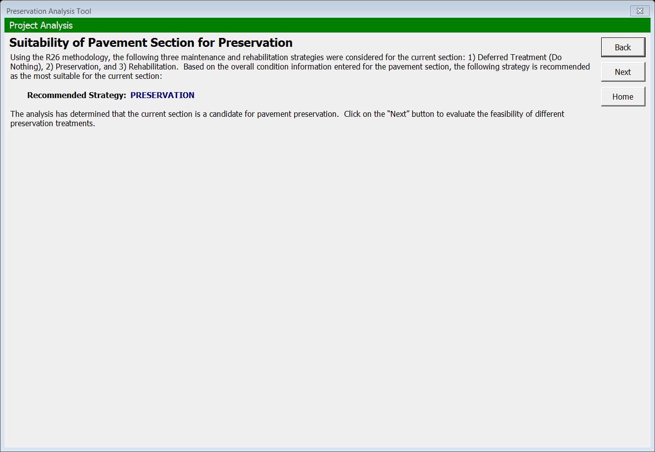
Project Analysis - Example (Cont.)
Notes:
With the 14 agencies presently participating, in total they executed 32 preservation project and placed over 40 preservation treatments on high volume traffic roadways.
We also conducted a Showcase in Mass on July of 2015 to review a project along Route 3 that had over 100,000 ADT,
Had an open house at MNRoads
Held three 4-hrs workshops
Held Quarterly Usergroup webinars,
And conducted 1 peer exchange, with two more scheduled in the near future (at Williamsport, PA on 29 June 2016 and St. Louis, MO on 9 Aug 2016)
This is just an example of the activities typically provided for each solution being implemented.

Slide 38
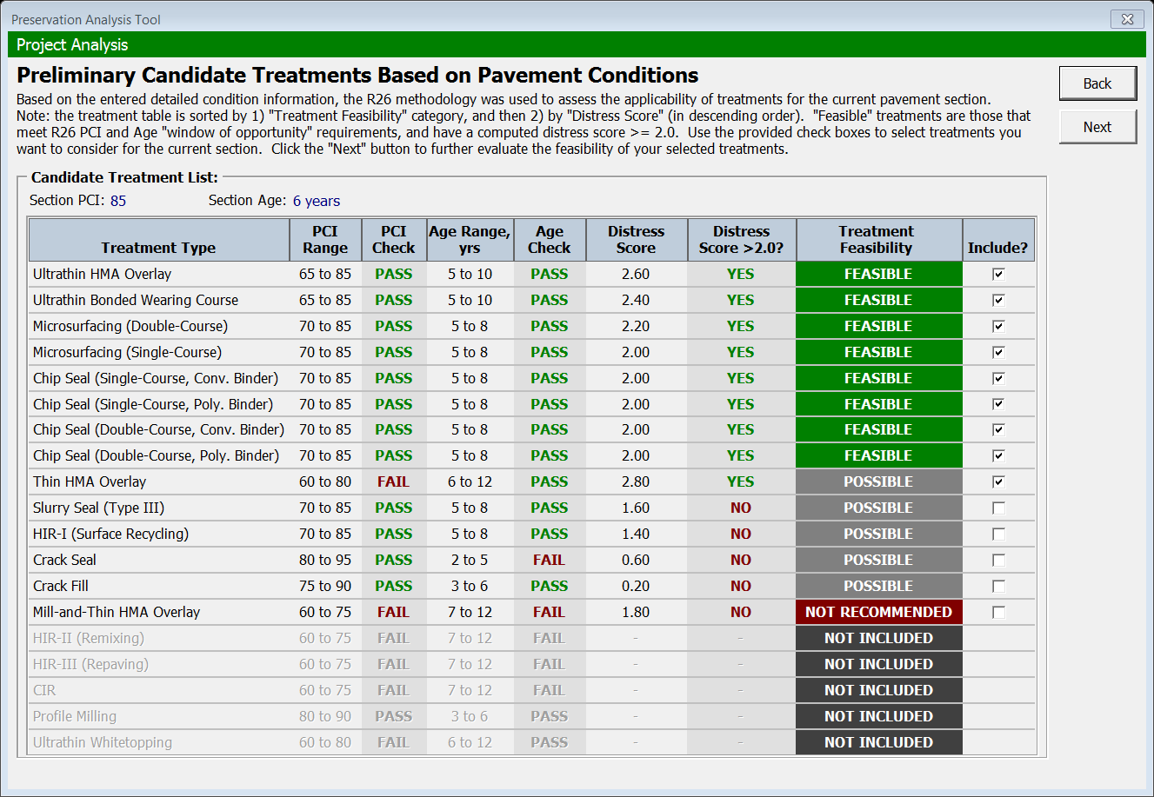
Project Analysis - Example (Cont.)
Notes:
With the 14 agencies presently participating, in total they executed 32 preservation project and placed over 40 preservation treatments on high volume traffic roadways.
We also conducted a Showcase in Mass on July of 2015 to review a project along Route 3 that had over 100,000 ADT,
Had an open house at MNRoads
Held three 4-hrs workshops
Held Quarterly Usergroup webinars,
And conducted 1 peer exchange, with two more scheduled in the near future (at Williamsport, PA on 29 June 2016 and St. Louis, MO on 9 Aug 2016)
This is just an example of the activities typically provided for each solution being implemented.

Slide 39
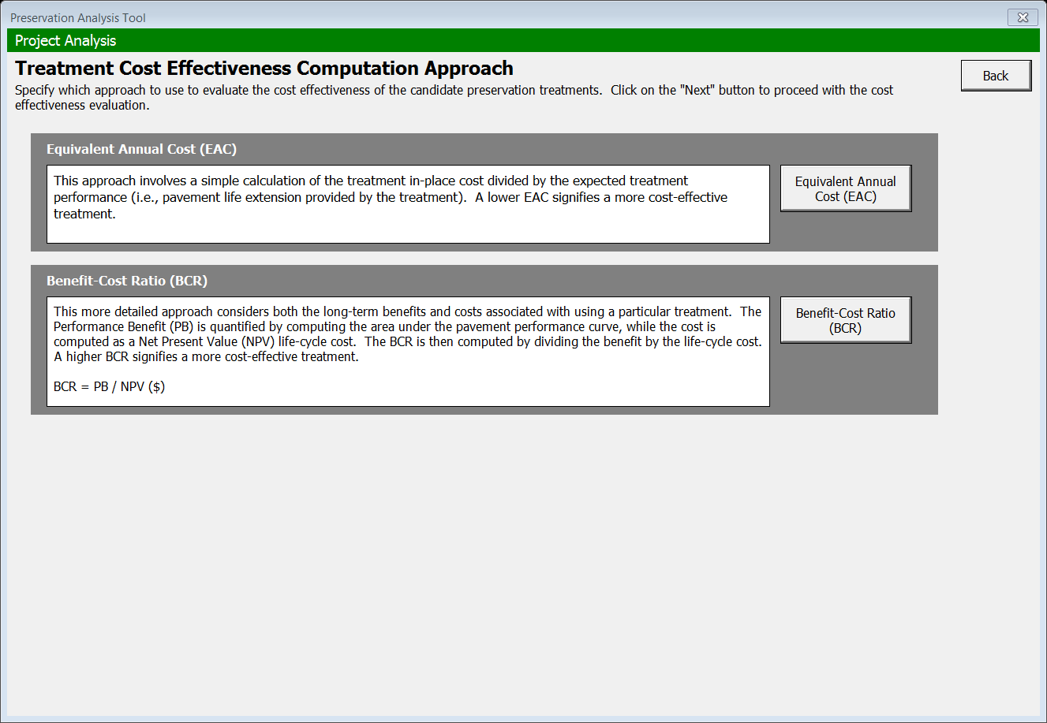
Preservation Analysis Tool Example (Cont.)
Notes:
With the 14 agencies presently participating, in total they executed 32 preservation project and placed over 40 preservation treatments on high volume traffic roadways.
We also conducted a Showcase in Mass on July of 2015 to review a project along Route 3 that had over 100,000 ADT,
Had an open house at MNRoads
Held three 4-hrs workshops
Held Quarterly Usergroup webinars,
And conducted 1 peer exchange, with two more scheduled in the near future (at Williamsport, PA on 29 June 2016 and St. Louis, MO on 9 Aug 2016)
This is just an example of the activities typically provided for each solution being implemented.

Slide 40
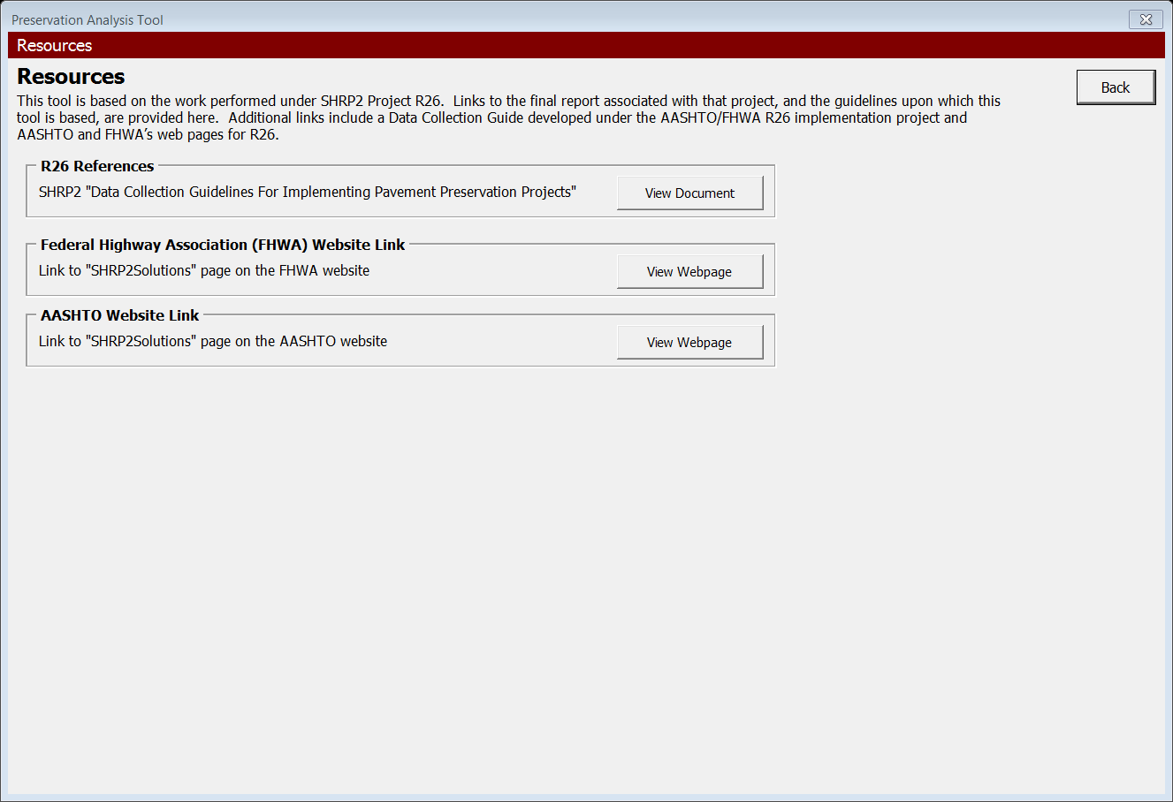
Resources Example
Notes:
With the 14 agencies presently participating, in total they executed 32 preservation project and placed over 40 preservation treatments on high volume traffic roadways.
We also conducted a Showcase in Mass on July of 2015 to review a project along Route 3 that had over 100,000 ADT,
Had an open house at MNRoads
Held three 4-hrs workshops
Held Quarterly Usergroup webinars,
And conducted 1 peer exchange, with two more scheduled in the near future (at Williamsport, PA on 29 June 2016 and St. Louis, MO on 9 Aug 2016)
This is just an example of the activities typically provided for each solution being implemented.

Slide 41
Thank You
Questions?
Contact Information:
Stephen J. Cooper
Pavements & Materials Engineer
FHWA Resource Center
Phone: 443-257-7145
stephen.j.cooper@dot.gov
Notes:
41

